Slide 1

Sharing of Service
Building Relationships through Service

Slide 2
Sharing of Service
“When we finally realize that we are sick and tired of being sick and tired, we open a door to unlimited possibilities for change, for hope, and for a happier and richer life.”
How Al-Anon Works, Ch. 3 Finding Help
Copyright 1995, 2008, Al-Anon Family Group Headquarters, Inc. Reprinted with permission of Al-Anon Family Group Headquarters, Inc. for one-time use only by the Sharing of Service Workshop

Slide 3
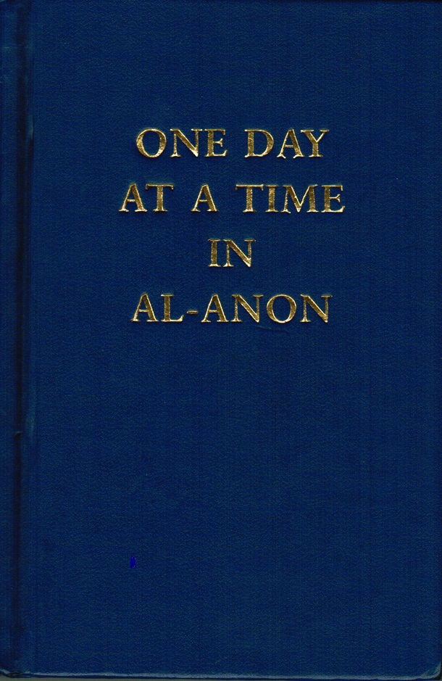
Sharing of Service
“We come to Al-Anon because we believe it has something we want.
In other words, we come to get something for ourselves.
At first, we have no idea that this getting is intimately involved with giving.”
One Day at a Time, October 14th
Copyright 1968, 1972, 2000, Al-Anon Family Group Headquarters, Inc. Reprinted with permission of Al-Anon Family Group Headquarters, Inc. for one-time use only by the Sharing of Service Workshop

Slide 4
Sharing of Service
“Sponsorship is another superb and rewarding form of service.”
How Al-Anon Works, Ch. 14 Service
Copyright 1995, 2008, Al-Anon Family Group Headquarters, Inc. Reprinted with permission of Al-Anon Family Group Headquarters, Inc. for one-time use only by the Sharing of Service Workshop

Slide 5
Sharing of Service
Service (is) “Putting Love into Action”
How Al-Anon Works, Ch. 14 Service
Copyright 1995, 2008, Al-Anon Family Group Headquarters, Inc. Reprinted with permission of Al-Anon Family Group Headquarters, Inc. for one-time use only by the Sharing of Service Workshop

Slide 6
Sharing of Service
“Unconditional love asks for nothing except expression.
It blesses both the giver and the receiver.”
How Al-Anon Works, Ch. 14 Service
Copyright 1995, 2008, Al-Anon Family Group Headquarters, Inc. Reprinted with permission of Al-Anon Family Group Headquarters, Inc. for one-time use only by the Sharing of Service Workshop

Slide 7
Sharing of Service
“Love with no strings attached is a foreign concept for many of us.
Some of us experience it for the first time when we come to Al-Anon.
Yet our survival as a fellowship depends on unconditional love.”
How Al-Anon Works, Ch. 14 Service
Copyright 1995, 2008, Al-Anon Family Group Headquarters, Inc. Reprinted with permission of Al-Anon Family Group Headquarters, Inc. for one-time use only by the Sharing of Service Workshop

Slide 8
Sharing of Service
“It takes practice to learn to love unconditionally … Service in Al-Anon allows us to stretch ourselves and to practice the Al-Anon principles while we connect with others.”
How Al-Anon Works, Ch. 14 Service
Copyright 1995, 2008, Al-Anon Family Group Headquarters, Inc. Reprinted with permission of Al-Anon Family Group Headquarters, Inc. for one-time use only by the Sharing of Service Workshop

Slide 9

Sharing of Service
“You learn to speak by speaking, to study by studying, to run by running, to work by working; and just so you learn to love God and man by loving.
Begin as a mere apprentice and the very power of love will lead you on to become a master of the art.” Francis de Sales
Courage to Change, November 12th
Copyright 1992, Al-Anon Family Group Headquarters, Inc. Reprinted with permission of Al-Anon Family Group Headquarters, Inc. for one-time use only by the Sharing of Service Workshop

Slide 10
Sharing of Service
“Service is an opportunity to gain self-esteem by doing something of value.”
How Al-Anon Works, Ch. 14 Service
Copyright 1995, 2008, Al-Anon Family Group Headquarters, Inc. Reprinted with permission of Al-Anon Family Group Headquarters, Inc. for one-time use only by the Sharing of Service Workshop

Slide 11
Sharing of Service
“We discover that when we reach out to others, our own pain diminishes, and our recovery begins to soar.”
How Al-Anon Works, Ch. 14 Service
Copyright 1995, 2008, Al-Anon Family Group Headquarters, Inc. Reprinted with permission of Al-Anon Family Group Headquarters, Inc. for one-time use only by the Sharing of Service Workshop

Slide 12
Sharing of Service
“Another form of service is submitting our written thoughts and experiences to the Literature Committee at the World Service Office.
Such contributions are essential to the creation of new up-to-date, relevant literature.”
How Al-Anon Works, Ch. 14 Service
Copyright 1995, 2008, Al-Anon Family Group Headquarters, Inc. Reprinted with permission of Al-Anon Family Group Headquarters, Inc. for one-time use only by the Sharing of Service Workshop

Slide 13
Sharing of Service
“The more love we offer, the more love we will find within ourselves.
The only real way to keep the riches we receive is to give them away.”
How Al-Anon Works, Ch. 14 Service
Copyright 1995, 2008, Al-Anon Family Group Headquarters, Inc. Reprinted with permission of Al-Anon Family Group Headquarters, Inc. for one-time use only by the Sharing of Service Workshop

Slide 14

Sharing of Service
“If I don’t take the action to trust, my Higher Power has nothing to work with.”
Hope for Today, June 14th
Copyright 2002, Al-Anon Family Group Headquarters, Inc. Reprinted with permission of Al-Anon Family Group Headquarters, Inc. for one-time use only by the Sharing of Service Workshop

Slide 15

Sharing of Service
Action is Attraction
There is no growth in the comfort zone
2019 World Service Conference Theme
Copyright 2019, Al-Anon Family Group Headquarters, Inc. Reprinted with permission of Al-Anon Family Group Headquarters, Inc. for one-time use only by the Sharing of Service Workshop

Slide 16
Sharing of Service
“The only person who can love me the way I want to be loved is me.”
Courage to Change April 16th
“I can only learn to love myself if I am willing to learn who I am.”
Courage to Change January 24th
“Only by knowing the person I am, can I create the person I want to become.”
Courage to change November 28th
Copyright 1992, Al-Anon Family Group Headquarters, Inc. Reprinted with permission of Al-Anon Family Group Headquarters, Inc. for one-time use only by the Sharing of Service Workshop

Slide 17
Sharing of Service
Al-Anon service is a safe place to make mistakes.
Anonymous

